Slide 1
Health Care Reform & Justice Involved Populations
Prepared by: Colorado Criminal Justice Reform Coalition (CCJRC)

Slide 2
CCJRC
Eliminate the overuse of the criminal justice system and improve community health & safety
Policy advocacy
Trainings/Education
Campaigns
Resource for justice involved people

Slide 3
Presentation Roadmap
Opportunities offered by the Affordable Care Act (ACA)
Medicaid & Connect for Health Colorado
Eligibility of Justice Involved Individuals
Medicaid Structure: Accessing Physical & Behavioral Health Care Services
Resources & Considerations

Slide 4
Opportunities offered by the ACA
Majority of people in Colorado now have the opportunity to have health care coverage.
Over 100,000 justice involved people in Colorado on any given day.
Estimated 70% - 90% will be eligible for health insurance.
Providing health care, particularly behavioral health services, to justice involved individuals has been shown to reduce recidivism rates.

Slide 5
Health Care Reform Impact
An estimated 70% - 90% of justice involved individuals are now eligible for Medicaid.
Potential Impact to:
Improve the health of justice involved individuals.
Stop the revolving door.
Promote alternatives to the overuse of the CJ system.

Slide 6
Comprehensive Coverage
10 Essential Health Benefits must be offered
Free preventative coverage
Mental health and substance use disorder coverage at parity
Ambulatory patient services
Emergency Services
Hospitalization
Maternity/newborn care
Mental health/substance abuse
Prescription drugs
Rehabilitative and habilitative services and devices
Laboratory services
Preventive and wellness care/chronic disease management
Pediatric services, including oral and vision care

Slide 7
Medicaid & Connect for Health Colorado 101
Medicaid
Public health insurance program for low-income individuals
Colorado Department of Health Care Policy & Financing (HCPF)
Can enroll anytime
Estimated 2/3 of justice involved population will be eligible for Medicaid
Connect for Health Colorado (Marketplace)
Marketplace to purchase private health insurance & apply for tax subsidy to help cover the cost of purchasing health insurance
Can choose from a variety of health plans
Open enrollment period or qualifying life event

Slide 8
Eligibility Depends on Income & Family Size
Medicaid
Expanded to cover the vast majority of Coloradans up to 133% FPL (about $1300/month) for a single adult.
Connect for Health Colorado (Marketplace)
Private insurance, including tax subsidies to those up to 400% FPL (about $3800/month) for a single adult.
Family size is based on who you claim and how you file your taxes, not necessarily who lives with you.
If you are eligible for Medicaid, you cannot be eligible for tax credits to purchase private insurance.

Slide 9
Coverage Up to Age 26
Medicaid
Former Foster Care
Eligible for individuals who were in foster care at ages 18 – 21 & enrolled in Medicaid
No income test for eligibility
Connect for Health Colorado
Plan must cover children (dependents)
Children can join or remain on a parent's plan even if they are:
Married
Not living with their parents
Attending school
Not financially dependent on their parents
Eligible to enroll in their employer’s plan
Notes:
Pause here for any questions before going further………

Slide 10
Options for Pregnant Women & Children
Medicaid
Pregnant Women Up to 195% FPL (about $1900/month)
Children Up to 142% FPL (about $1400/month)
Presumptive eligibility
CHP+ (Child Health Plan Plus)
Up to 260% FPL (about $2500/month)
Under the age of 19 or pregnant
Enrollment fees and small co-pays may be required

Slide 11
Eligibility and Enrollment of Justice Involved Populations

Slide 12
Eligibility Depends on CJ Status
Most justice involved individuals will be eligible for coverage.
Clients are NOT eligible for coverage if:
they are an inmate of a public institution (i.e., under the control of state, county, federal government or municipality)

Slide 13
Eligibility during Pretrial Phase
Pretrial Status | Eligible for Medicaid? | Marketplace
 |  | Eligible for Coverage? | Eligible for Tax Credits?
- On bond or diversion pending disposition | Yes | Yes | Yes
- In jail pending disposition | No* | Yes** | Yes
* The jail or prison facility is responsible for all health care services provided in-house. Medicaid can reimburse for medical care provided to an incarcerated person admitted as an inpatient in a hospital for at least 24 hours.
** Private insurance may pay for inpatient or outpatient services received while someone is in jail pretrial as long as the person continues to pay premiums and receives treatment in-network.

Slide 14
Eligibility while serving a sentence
Serving Sentence | Eligible for Medicaid? | Marketplace**
 |  | Eligible for Coverage? | Eligible for Tax Credits?
In Jail | No* | No | No
In Prison | No* | No | No
Probation | Yes | Yes | Yes
Parole | Yes | Yes | Yes
* The jail or prison facility is responsible for all health care services provided in-house. Medicaid can reimburse for medical care provided to an incarcerated person admitted as an inpatient in a hospital for at least 24 hours.
**Marketplace enrollment must be discontinued within 30 days of being sentenced to a period of incarceration.
Notes:
- Person can start the Medicaid application 41 days prior to release.
- Release from incarceration is considered qualifying life event to allow someone to purchase health insurance from the Marketplace. Have 60 days grace period.

Slide 15
Eligibility in Community Corrections (“halfway house”)
Community Corrections | Eligible for Medicaid? | Marketplace
 |  | Eligible for Coverage? | Eligible for Tax Credits?
- - Residential & Non-Residential | Yes | Yes | Yes
The Center for Medicare & Medicaid Services published guidance on April 28, 2016 that allowed for people in Community Corrections to be eligible for Medicaid.
The Colorado Department of Health Care Policy & Financing published guidance on June 1, 2016 stating that all residents of Community Corrections facilities in Colorado, except for one facility in Colorado Springs, are eligible for Medicaid as long as they meet the income requirement.

Slide 16
Medicaid Structure:
Accessing Physical & Behavioral
Health Care

Slide 17
Medicaid Services Structure
Physical Health Care Coordination
Behavioral Health Managed Care
Behavioral Health Organizations (BHOs) are responsible for care coordination.
BHOs contract with community mental health centers and other treatment providers.
Accountable Care Collaborative (ACC) is Medicaid’s primary health care program.
It is comprised of Regional Care Collaborative Organizations (RCCOs) and Primary Care Medical Providers (PCMPs).
Variety of health plans within Medicaid.
Notes:
* Other Medicaid managed care plans include Denver Health Medicaid Choice, and Rocky Mountain Health Plan on the Western Slope.

Slide 18
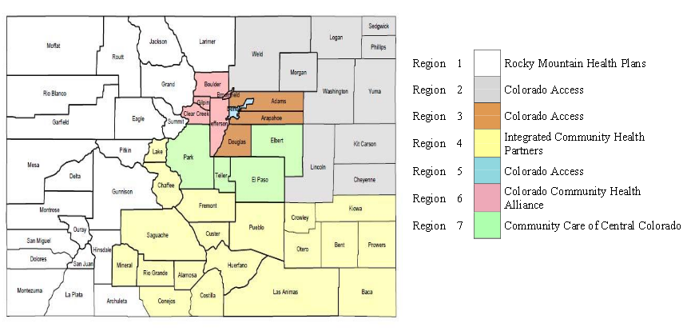
ACC Program – Regional Care Collaborative Organizations
Notes:
The Accountable Care Collaborative (ACC) program is Medicaid’s primary health care program
Medicaid members must choose to be enrolled in the ACC program and will also need to choose the doctor they would like to see
Once enrolled in the ACC, a person is assigned to a Regional Care Collaborative Organization (RCCO) that will help individuals find a doctor and coordinate healthcare services
There are 7 RCCOs in Colorado
Each RCCO can help connect an individual with a primary care provider (aka doctor)
RCCOs assign a Care Coordinator to each individual to help with navigating the healthcare system and accessing needed services, such as dental care

Slide 19
Sample of Medicaid Covered Benefits
Dental Care – up to $1000
Annual Physical Exam
Immunizations & Vaccines
Urgent Care Visits
Outpatient Surgery
Prescription Drugs
Preventative & Wellness Services
Chronic Disease Management
Emergency Room Visits
Transportation Services to/from appointments
Small co-pays may be required to receive some of these services

Slide 20
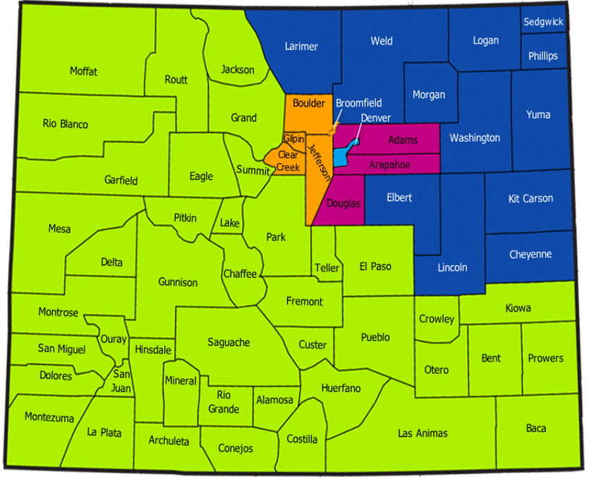
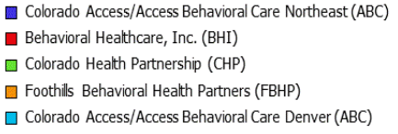
Behavioral Health Organizations
Notes:
There are 5 BHOs in Colorado
BHOs contract with the state to deliver both Substance Use Disorder & Mental Health services to Medicaid enrollees
Everyone enrolled in Medicaid is automatically assigned to a BHO within their community

Slide 21
Covered Mental Health Benefits
Inpatient hospital psychiatric care
Outpatient hospital psychiatric services
Psychiatrist services
Individual and group therapy
Medication management
Case management services
Emergency services
Vocational services
Clubhouse/drop-in centers
Assertive Community Treatment
Recovery services
Respite services
Prevention/early intervention activities
School-based and day treatment services for children/youth
Behavioral health services must be “medically necessary”

Slide 22
Covered Substance Use Disorder (SUD) Treatment Benefits
Alcohol and/or drug assessments
Social detox services
Individual & Group Therapy – Outpatient
Targeted Case Management
Drug screening & monitoring
Peer Advocate Services
Medication Assisted Treatment
Note: Residential SUD treatment is not a covered benefit

Slide 23
Considerations & Resources

Slide 24
Considerations
The criminal justice system may not be aware of or engaged in opportunities afforded by health care reform.
Many justice involved people have never had health insurance or a primary care provider.
Will greatly benefit from health care navigation services.
May have restrictions and requirements they must comply with that could affect the delivery of health services.
May be under a significant amount of stress that can be adversely affecting their health.

Slide 25
Considerations (cont.)
Have discussions with criminal justice agencies, including jail administrators & pretrial services, to establish & coordinate enrollment efforts.
Educate justice involved individuals about what having health insurance means and how to access services.

Slide 26
Resources
Establish relationships with county human services departments, Medical Assistance Sites and/or health coverage guides to help enroll justice involved individuals and their families.
Establish relationships with Community Safety Net Clinics and Federally Qualified Health Centers to help with enrollment & access to care.
Apply for Medicaid directly online: Colorado PEAK
Help participants download the PEAK Health Mobile App
Notes:
Staff trainings – Specific staff assigned -

Slide 27
Take Care Health Matters Campaign

Slide 28
Take Care Health Matters
Website
Resource Guide
Presentations & Trainings
Client Level Materials
Local/County Based Support
Stakeholder Groups

Slide 29
Questions? Comments? Discussion?
Terri Hurst, MSW
CCJRC Policy Coordinator
terri@ccjrc.org
303-825-0122
takecarehealthmatters.org
ccjrc.org

